Slide 1
Dart
Anjali Chachra

Slide 2
What is Dart
Developed by Google
Object oriented language
Runs on multiple environment

Slide 3
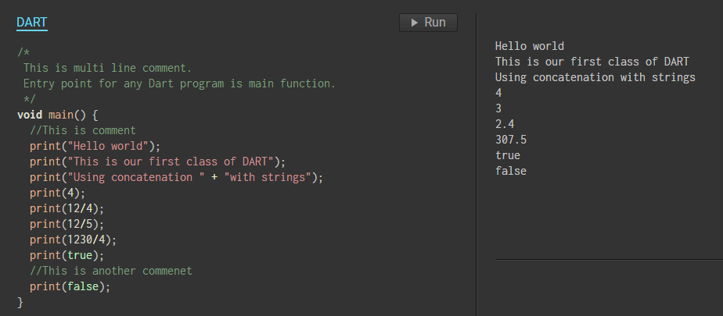
Program 1 - Print and comments

Slide 4
Program 2 - Datatypes and Variables
Datatypes:
int
double *All the datatypes in DART are objects.
String Therefore default values will be null.
boolean - bool
list
map
runes
symbols

Slide 5
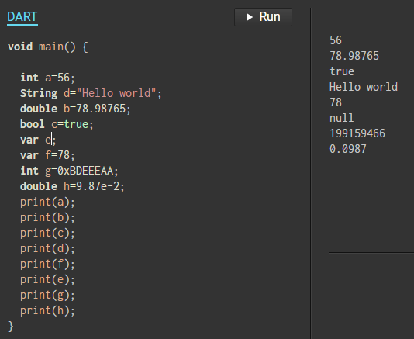
Program 2 - Datatypes and Variables

Slide 6
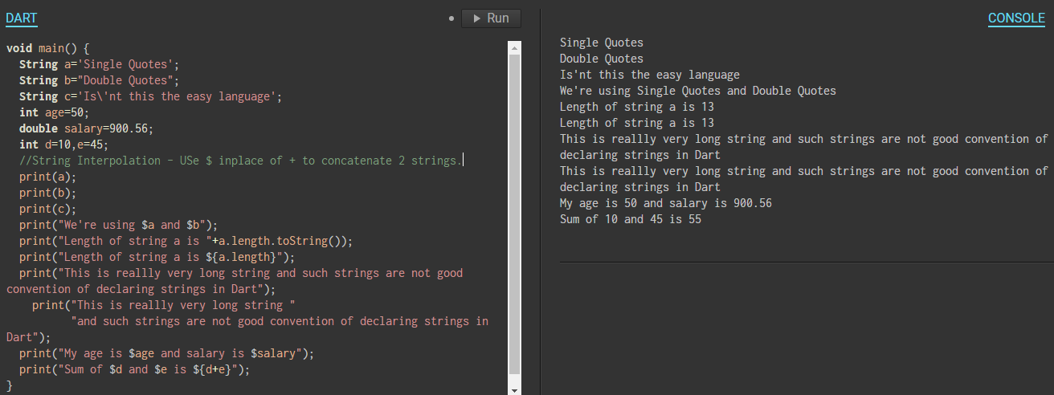
Program 3 - Strings, string literals, string interpolation

Slide 7
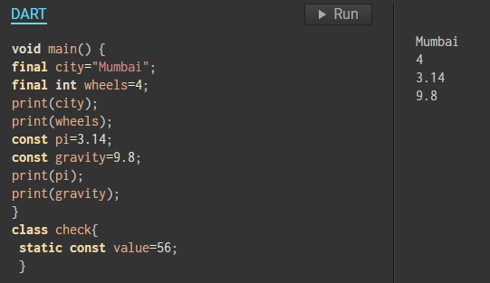
Program 4 - Defining Constants

Slide 8
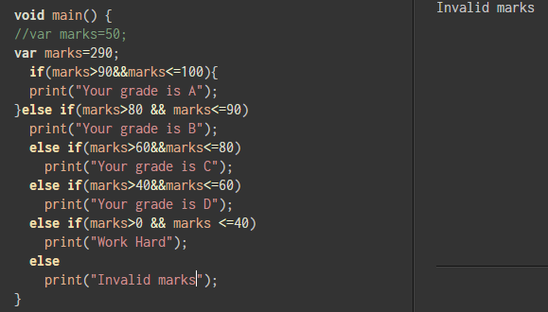
Program 5 - Control flow statements/conditional statements
if else statements
switch case

Slide 9
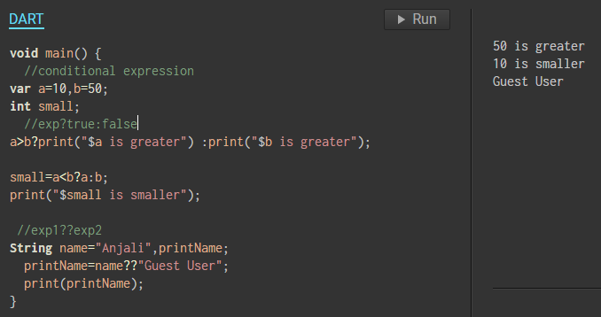
Program 6 - Conditional expressions

Slide 10
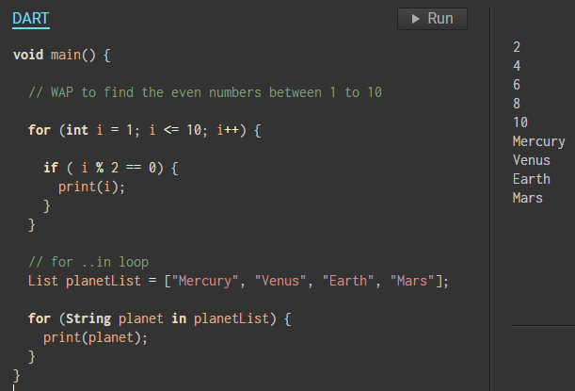
Program 7 - Loops
for
while

Slide 11
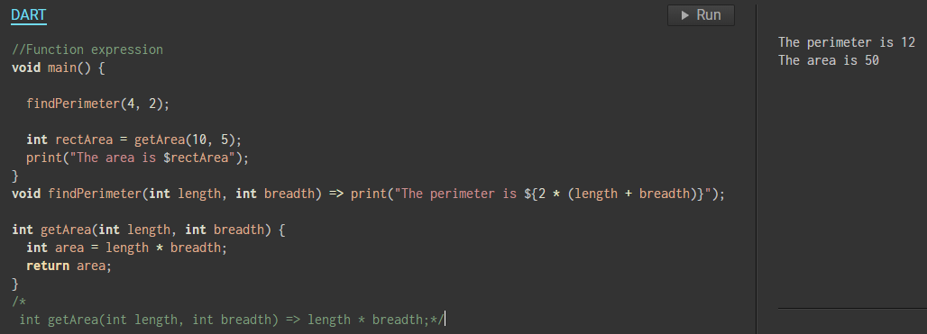
Program 8 - Function Expression

Slide 12
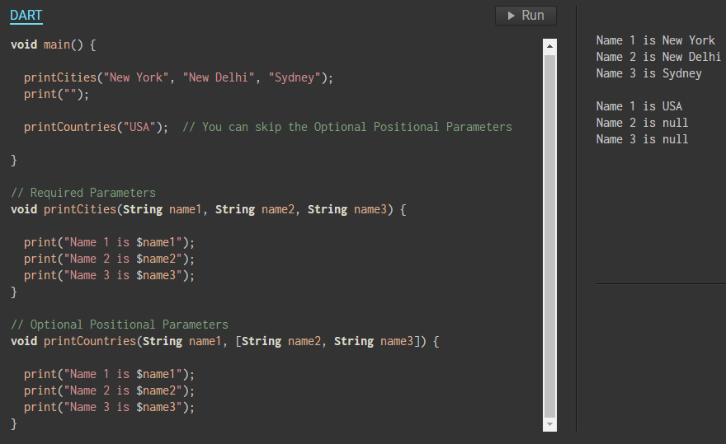
Program 9 - Required and optional parameters

Slide 13
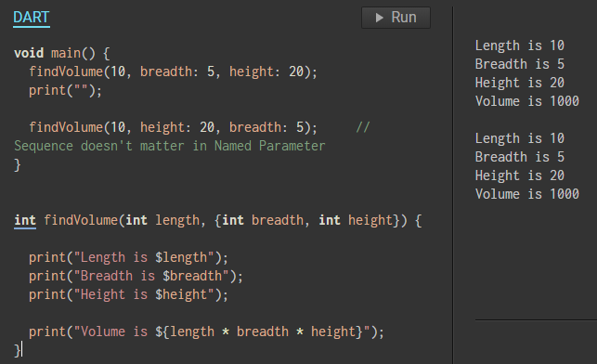
Program 10 - Named parameters

Slide 14
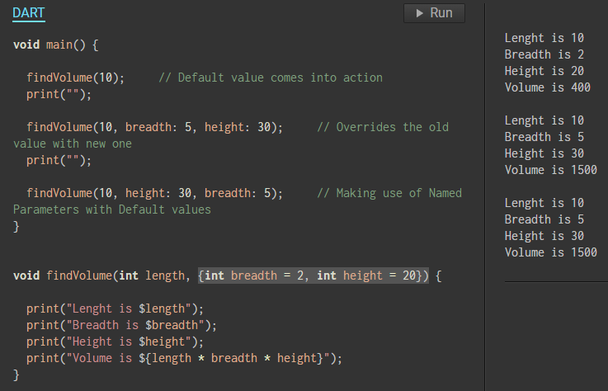
Program 11 - Default parameters

Slide 15
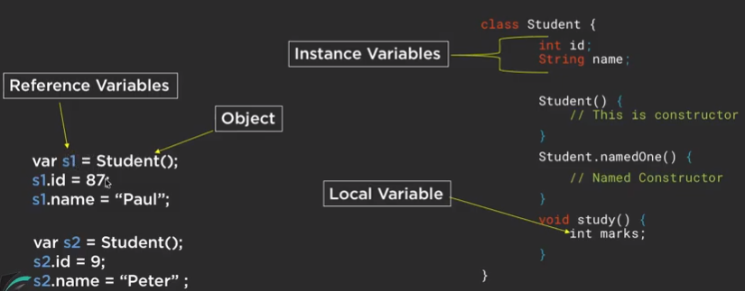
Object Oriented Dart
Class, objects, variables

Slide 16
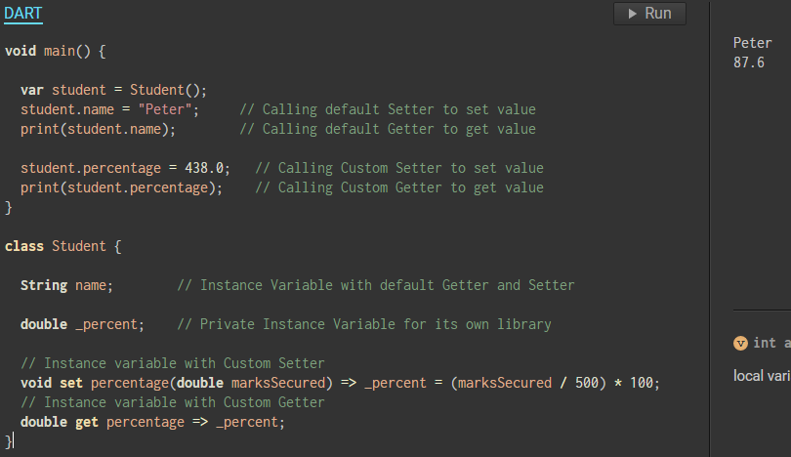
Object Oriented Dart
2. Getters and setters

Slide 17
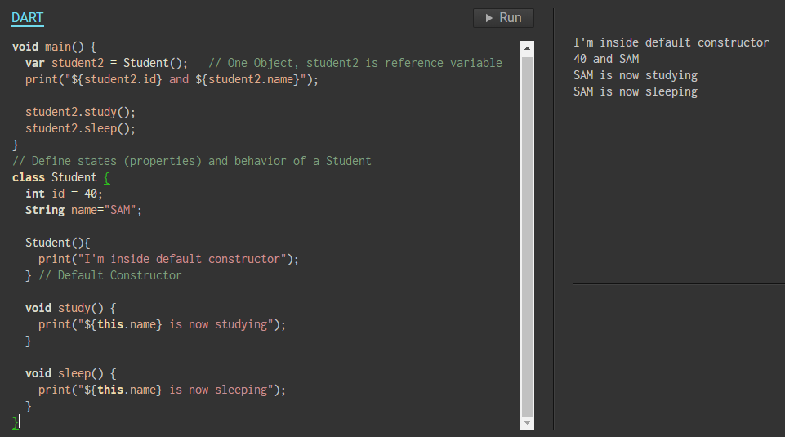
Object Oriented Dart
3. Constructors
Default
Parameter
Named

Slide 18
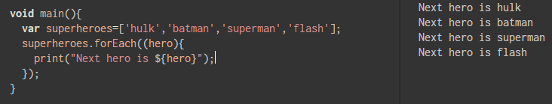
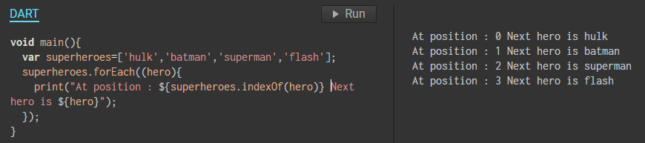
For each, call back

Slide 19
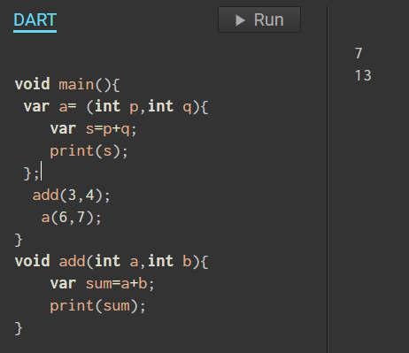
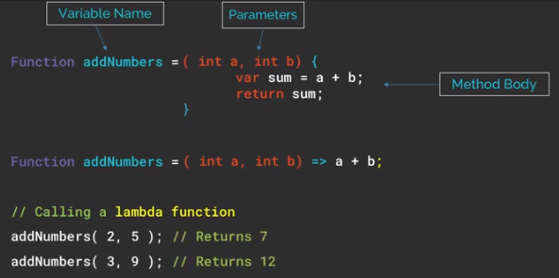
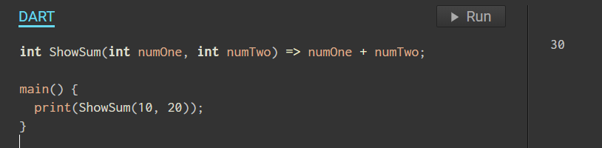
Lambda Expression
Syntax - return_type function_name(arguments) => expression;
v
v
Notes:
Lambda function is a nameless function.

Slide 20
Lambda Expression
void main(){
var multiplyByFour= (int p){
return p*4;
};
print(multiplyByFour(7));
}
Notes:
Lambda function is a nameless function.

Slide 21
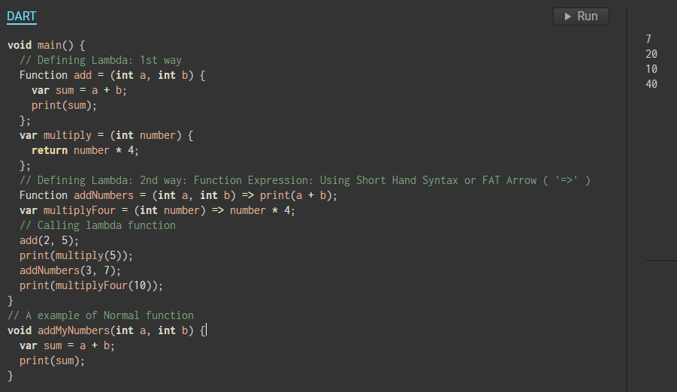
Lambda Expression
Notes:
Lambda function is a nameless function.

Slide 22
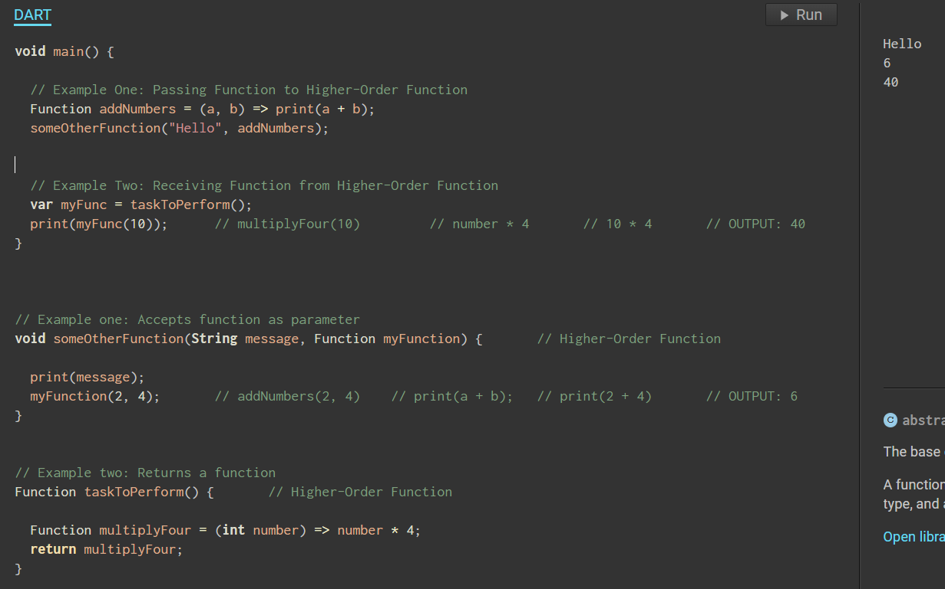
Higher order functions
Accept function as parameter
Return function as parameter
Notes:
Lambda function is a nameless function.

Slide 23
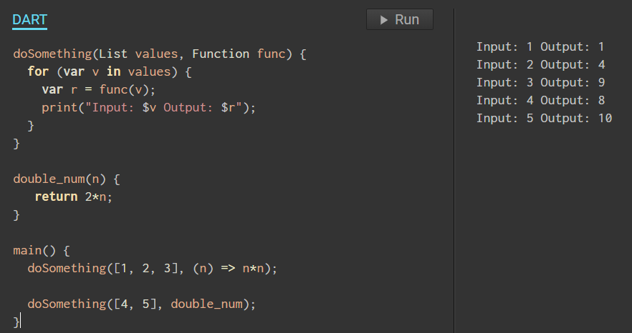
Higher order functions
Accept function as parameter
Return function as parameter
Notes:
Lambda function is a nameless function.

Slide 24
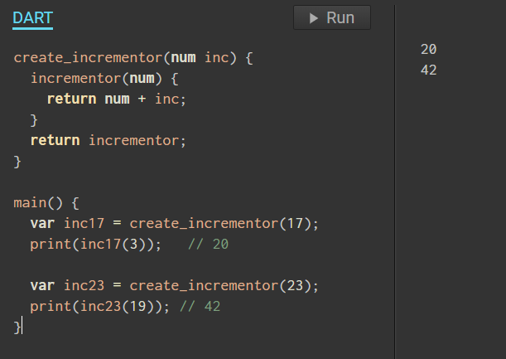
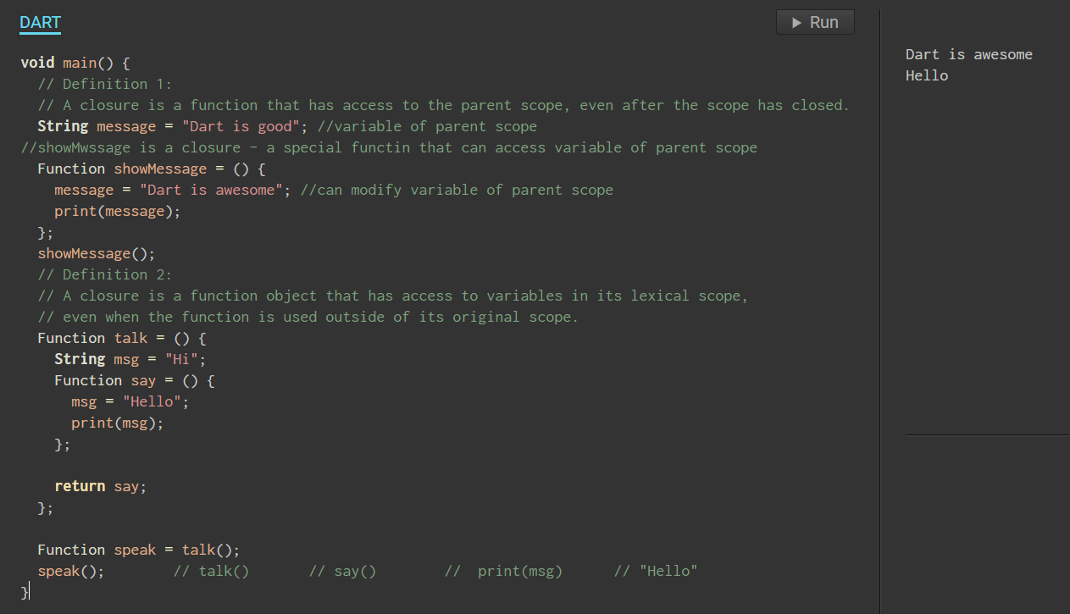
Lexical closures
A closure is a function that has access to the parent scope, even after the scope has closed.
A closure is a function object that has access to variables in its lexical scope, even when the function is used outside of its original scope.

Slide 25
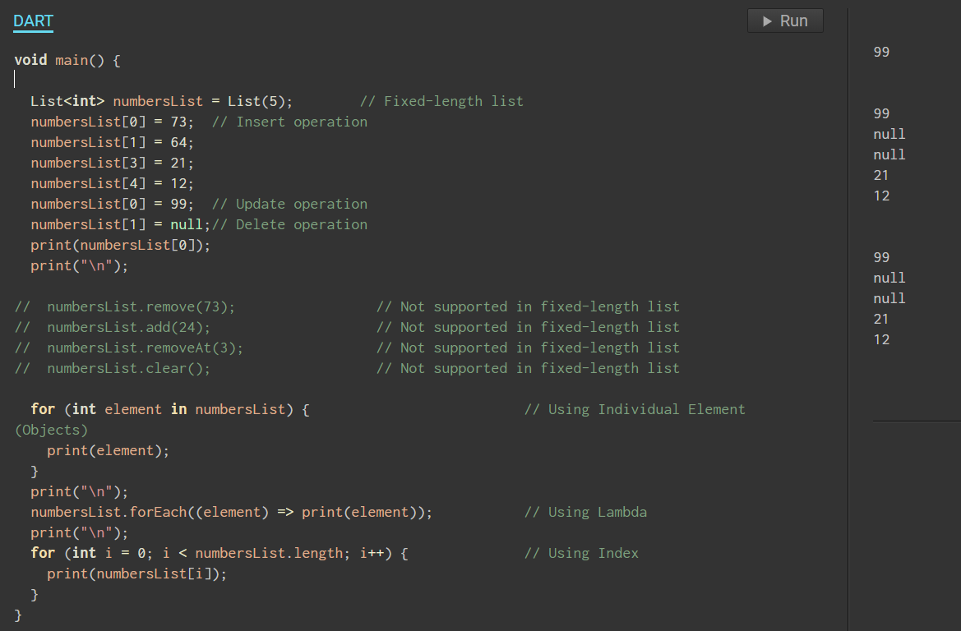
Lists
Fixed length
Growable

